Slide 1
Design Patterns Unveiled
Best Practices and Pitfalls for Modern Software Development
Chris Steele

Slide 3

Today’s Discussion
1
Brief Intro
2
Presentation Overview
3
Patterns and Anti-patterns
4
Wrap-up
5
Q&A

Slide 4
Speaker Introductions

Slide 5



Speakers
Gregg Flagg
Chris Steele
Director of Consulting, Improving Ohio
Architect and technical leader with over 25 years of experience in the industry.
Areas of expertise are hyperscale cloud systems, Connected Vehicle platforms, Internet-of-Things (IoT), performance engineering and solution architecture in highly diverse technology portfolios.
Director of Consulting, Improving Ohio
IT professional with over thirteen years of experience delivering quality-driven software solutions.
Focuses on providing highly scalable and maintainable web and cloud-based solutions.

Slide 6


About Me

Slide 7
Presentation Overview

Slide 8
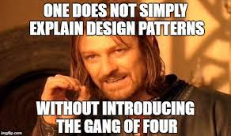
About this talk…
Why talk about patterns?
What we’ll cover
What is a design pattern?
“A common solution to a recurring problem”
Patterns form at different levels
Architectural
Design
Code/implementation
Not just cloud.
Patterns vs. anti-patterns
An introduction to some of my favorite
And not-so-favorite anti-patterns
The idea is to give you a small taste of what’s out there
And hopefully leave you with a desire to learn more and apply to your own projects
Notes:
Touch on the fact that people are likely already using some of these without knowing

Slide 9
Patterns and Anti-Patterns

Slide 10
Synchronous I/O anti-pattern
Problem
Solution
Systems almost always can be subjected to unexpected heavy load
Especially with cloud systems, achieving horizontal scalability (“scale-out”) means minimizing synchronous patterns
Always be asking “can I make this asynchronous?”
While very true at the design level, this is also true at the code level
Any code you write that performs I/O is a potential culprit
Database reads/writes
External API calls
Blob storage, queue operations, file system updates
Etc. Etc. Etc.
Embrace asynchronous patterns
At the design and code levels
Always utilize framework-level async methods
The async/await pattern in C#
Don’t forget your async methods when writing common components/frameworks
Caveat
Not always a single silver bullet that guarantees great performance

Slide 11
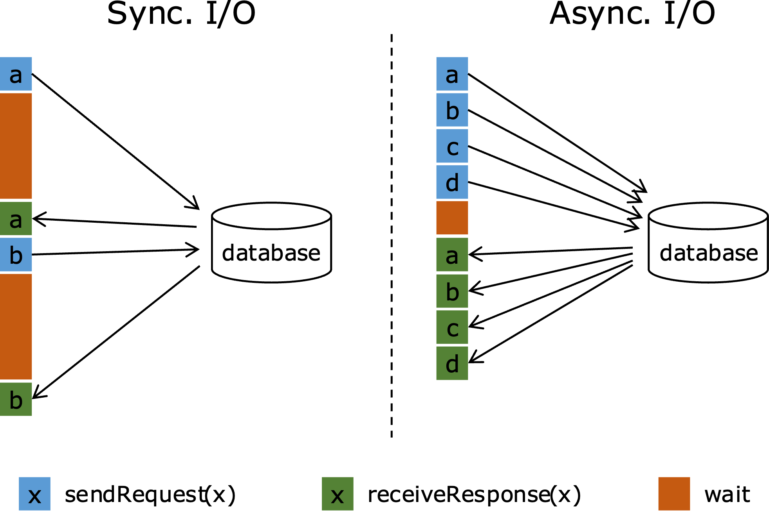
Notes:
Image source: https://nightlies.apache.org/flink/flink-docs-release-1.13/docs/dev/datastream/operators/asyncio/

Slide 12
Queue-Based Load Leveling pattern
Problem
Solution
Services that are part of your solution may be subject to intermittent heavy load
SQL databases
Storage services
External APIs
Unpredictable spikes can overload the service
Timeouts, throttling limits, seriously degraded response times
The concurrent nature of the heavy load is often the culprit
Introduce a queue between the caller and the service
Rather than directly calling the service, the client puts a message on a queue
A receiver on the other end picks up messages from the queue at a steady, consistent rate then performs the actual work
Such as calling an external API or making a database update
During high volume, messages can be enqueued as quickly as necessary but dequeued and processed at a rate appropriate for the service
Thus “leveling” the load
Caveats
This pattern is inherently one-way. If a given task requires a response, additional mechanisms are required
Rate leveling can be hard to implement correctly
Load test early and often

Slide 13
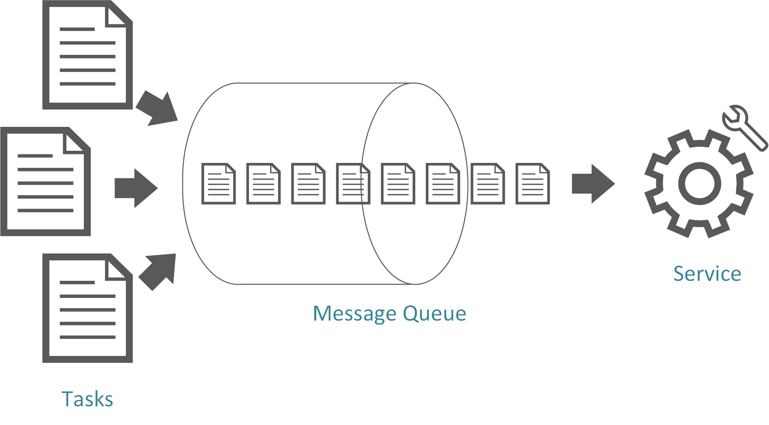
Notes:
Image source: https://blog.cdemi.io/design-patterns-queue-based-load-leveling-pattern/

Slide 14
Claim Check pattern
Problem
Solution
Message-based architectures often need to handle large messages
“User updates their profile pic”
“CT machine sends images to radiologist”
“Artist uploads new album tracks”
Your first instinct might be to store these large payloads in the messages
You are not alone 🙈
“Azure Service Bus messages can be 100 MB!”
Just because you can, doesn’t mean you should
This will result in slow enqueuing and dequeuing
Trust me
Store the payload in a fast, cheap storage mechanism and only pass the reference in the message
Reference = the Claim Check
Like passing around a claim check that you ultimately use to pick up a piece of luggage
Usually something simple like a GUID or URL
This works especially well in a complex architecture where a message is enqueued/dequeued multiple times but where each consumer does not need to process the (whole) payload
NoSQL databases and Azure Blob Storage work well for this pattern
Caveat
Additional load and latency caused by write/reads

Slide 15
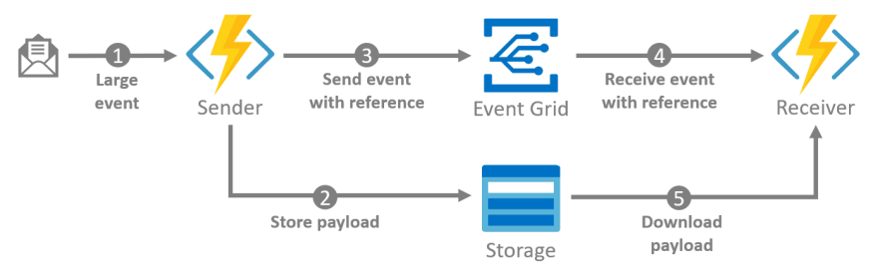

Slide 16
Eventual Consistency pattern
Problem
Solution
Many (most?) systems are designed to be strongly consistent
Data at all points is always consistent, all the time
Especially true of SQL-based data stores
The old “ACID” properties
But when you’re building really highly scalable, large cloud-based systems, this becomes a problem
Read: impossible
Geographically disperse data stores should not/cannot be made to be updated simultaneously everywhere
Think about a geo-replicated social media application that runs in literally dozens of data centers around the world
And what about availability? What happens with a catastrophic failure of a data center? Or long-running outage?
“Applications must lie” – Uli Homann, Microsoft
Core concept: updates can ripple through the system (at their own pace) if the system eventually becomes consistent
Does it matter if a social media user in the US sees another user’s post 30 seconds after someone in Europe?
Simple concept. Not so simple to implement.
So how do we achieve it?
First, start considering the consistency needs of each dataset with your system independently
Mixing consistency models is very common
Put these tools in your toolbox
Idempotency
Compensating transactions
Data partitioning
Take advantage of the platform capabilities in Azure!

Slide 17
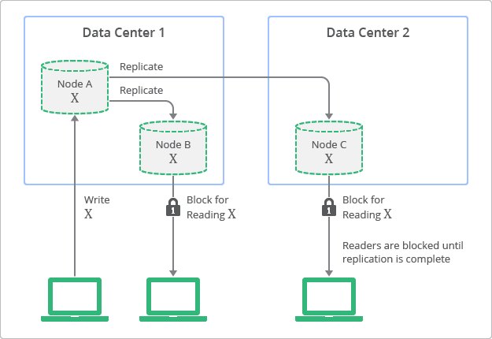
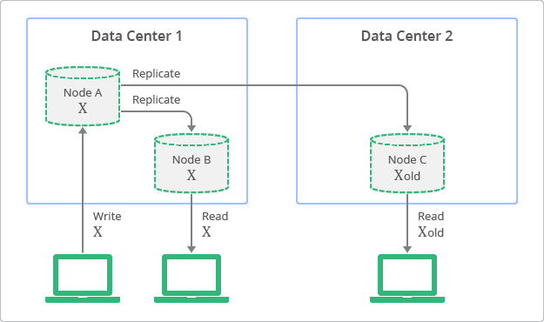
Notes:
Image source: https://cloud.google.com/datastore/docs/articles/balancing-strong-and-eventual-consistency-with-google-cloud-datastore

Slide 18
Cache-Aside pattern and No Caching anti-pattern
Problem
Solution
Hot take: caching data is good
But… implementing a cache can sometimes be tricky
“All caching implies policy”
Getting expiration and eviction correct for your app is not always straightforward
A cache should sometimes be treated as eventually consistent
There are multiple caching patterns, so carefully select the one(s) you’ll use
Read-through
Write-through
Write-behind
Cache-aside
More…
The Cache-Aside pattern is also known as “lazy loading”
The idea is that the application first checks the cache for the required data
If it’s not found, the app requests from the database
Then the app updates the cache
Contrast this with the other caching patterns in which the app treats the cache as always (strongly) consistent
Notes:
Read-Through – lazy-loading
Write-Through – always write to cache and then cache to db
Write-behind – Same as write through but async

Slide 19
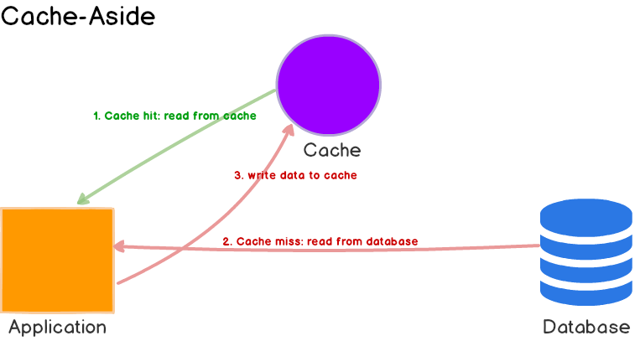
Notes:
Image source: https://codeahoy.com/2017/08/11/caching-strategies-and-how-to-choose-the-right-one/

Slide 20
Circuit Breaker, Retry (patterns), and Retry Storm anti-pattern
Problem
Solution
Distributed environments inevitably fail due to various transient faults
We’re often more focused happy path
Left unhandled often leads to unnecessary resource constraints
Increase focus on non-happy path
Track failures in a stateful manner
Closed – defined failure threshold with smart retry
Open – no calls based on timer
Half-Open – defined success count
Consider business requirements
Fail fast for non-critical operations
Monitor and adjust
Notes:
Talk about what to avoid with retry storm
Exponential backoff – retry after 1s and then 2 and then 4 etc.
Azure services – retry often – be more aggressive
Smart retry – 429 too many requests (throttled?), 404 not found,
Business requirements – transient errors could mean something entirely different

Slide 21
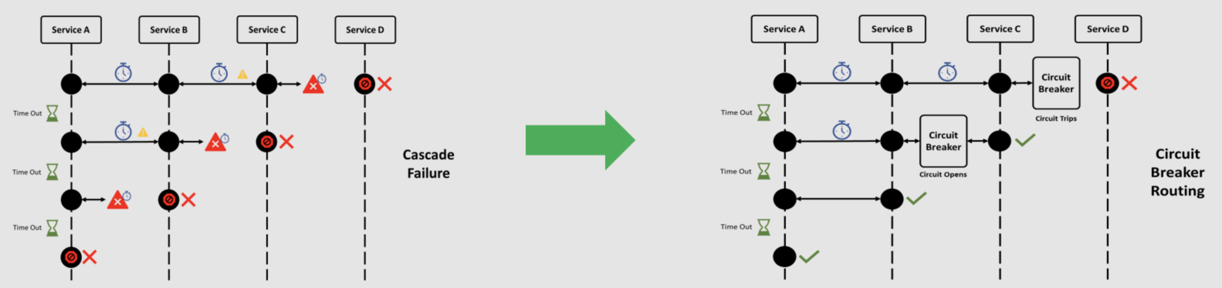
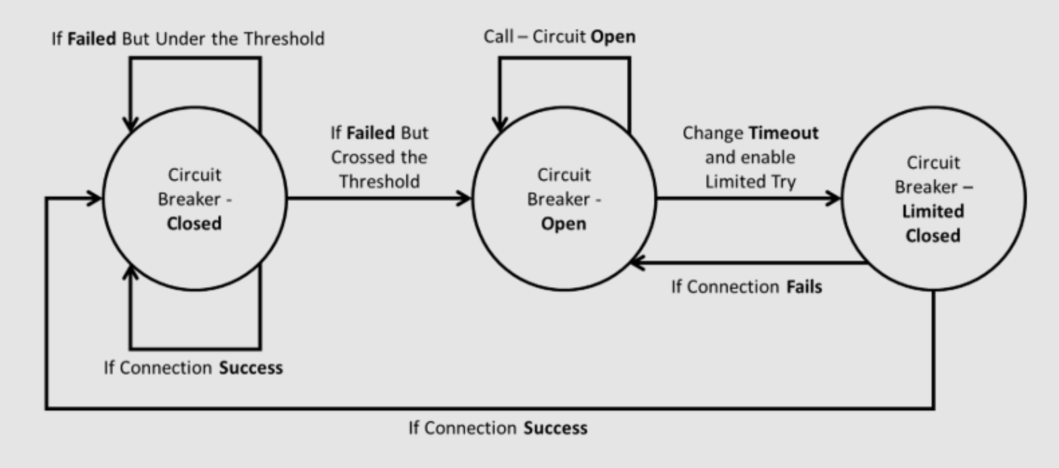
Notes:
Image source: https://digitalvarys.com/what-is-circuit-breaker-design-pattern/

Slide 22
Throttling pattern
Problem
Solution
The cloud gives the impression of “infinite” resources!
Relying solely on auto-scaling can become very expensive and hide underlying issues
”The more requests, the better!”
Define a Service Level Agreement (SLA)
Analyze your traffic
Find patterns
Auto-scale with purpose
Get creative but not toooo creative!
Reject requests after # times
Degrade quality
Load leveling
Defer operations

Slide 23
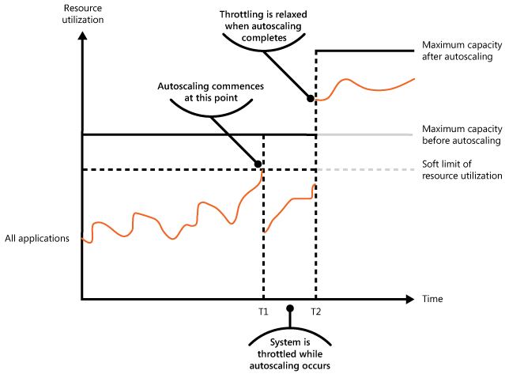
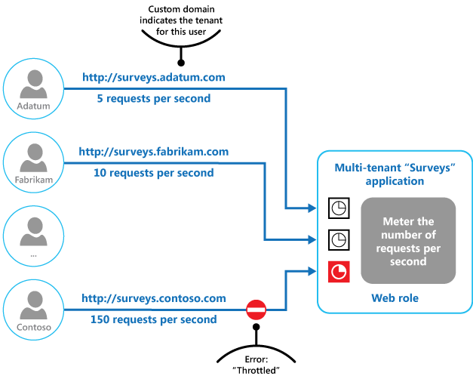
Notes:
Image source: https://learn.microsoft.com/en-us/azure/architecture/patterns/throttling

Slide 24
Chatty I/O, Busy Database, Extraneous Fetching anti-patterns
Problem
Solution
High latency and low throughput – users complaining
Object oriented programming != database queries (ORM Problems)
Lack of understanding of what performs I/O operations vs in-memory operations
Entity Framework in-memory operations (IEnumerable vs IQueryable)
Predicting the future is like playing darts with a blindfold – you’re bound to miss the target
Pushing too many operations to the database
XML, string manipulation, complex calculations, etc.
YAGNI (You ain’t gonna need it)
Sometimes throw best practices out the door!
Monitor database performance and adjust
Prefer memory transactions over I/O – mostly
Sometimes it is better to keep objects
Notes:
Unattended consequences of using an ORM
Used to be that we should push everything to the db – chunky over chatty

Slide 25
Gateway Offload pattern
Problem
Solution
Old habits die hard!
Auth, SSL, logging, monitoring, throttling are all solved problems
We don’t know what we don’t know!
Ignorance is bliss!
Simplification!
Larger focus on outcomes
Use a Gateway
App Gateway
Load Balancer
Front Door
API Management
Don’t forget the App Proxy
Notes:
Add build animations

Slide 26
Wrap-up

Slide 27

Wrapping up
Other good patterns to explore
External Configuration Store
Event Sourcing / Materialized View
Improper Instantiation
CQRS
Pipes and Filters
AI & ML Design Patterns
Lots more!

Slide 28
Wrapping Up
Where to go from here?
Build familiarity with common patterns and anti-patterns
Recognize where you’re already using some in your projects
Keep patterns in mind when designing new systems and subsystems
And when writing code
Resources
Microsoft Cloud Design Patterns website
Martin Fowler’s writings
Enterprise Integration Patterns website
Well-Architected Framework
Caveat:
Be careful about assigning too much weight to the “classic” works in this space

Slide 29
Q&A

Slide 30


Thank you!
Notes:
Changes for future talks:
Add a non-verbal slide

Slide 31
TODO:
Add blurbs about ML and AI patterns
Add maybe one more pattern to talk about because it is a bit short

